Slide 1

University of science and Technology, Meghalaya
Department of
Computer Science and Electronics
Topic – Student Information System
Paper code –BCA 404
Presented by-
Gaurab Roy (17/BCA/44)
Rupanjan Sarkar(17/BCA/12)

Slide 2
Contents
Introduction
Objective
Tools and Technology used
Work breakdown structure
Dataflow diagram
ER diagram
Table structure
Data dictionary
Conclusion

Slide 3
1. Introduction
The “Student Information System” has been developed to overcome the problems existing in the manual system. This software is developed to eliminate and reduce the hardships faced by this existing system. Moreover this system is designed for the particular need of the administration to carry out operations in a smooth and effective manner.
This application is reduced as much as possible to avoid errors while entering the data. It also provides error message while entering invalid data. No formal knowledge is needed for the user to use this system. Thus, by this it proves that it is user-friendly. Student Information system, as described above, can lead to error free, secure, reliable and fast management system. It can assist the user to concentrate on their other activities rather to concentrate on the record keeping. Thus it will help organization in better utilization of resources.

Slide 4
2. Objective
The main objective of the project on Student Information System is to manage the details of the students. This project is totally built at administrative end and thus only the administrator is guaranteed the access. The purpose of the project is to build an application program to reduce the manual work for managing the information of the students. It showcases all the details of the student, their courses, address etc.

Slide 5
Advantages of using Student Information System:
Provides smart management of student’s data.
It manages the information of all the students.
Provides the facility of searching student’s information based on their enrollment number.
It provides editing, adding and updating of records which results in proper resource management of student data.
Accuracy in works.
Well designed reports.
Access of any information individually.

Slide 6
3. Tools and technology to be used
Hardware Specifications:
Processor : Intel Core i3
Hard Disk: 1 TB
RAM: 4 GB DDR3
Processor Variant: 6006U
Operating System: Microsoft Windows 10
Software used:
Operating System: Microsoft Windows 10
Front End: Microsoft Visual Studio 2008
Back End: MySql Server 2005

Slide 7
4. Work breakdown structure(WBS)

Slide 8
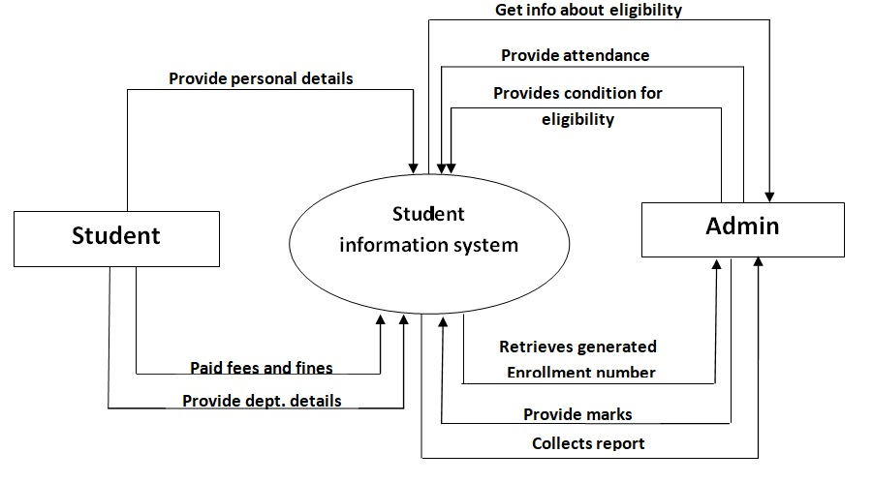
5. Dataflow diagram
i. Zero level dataflow diagram

Slide 9
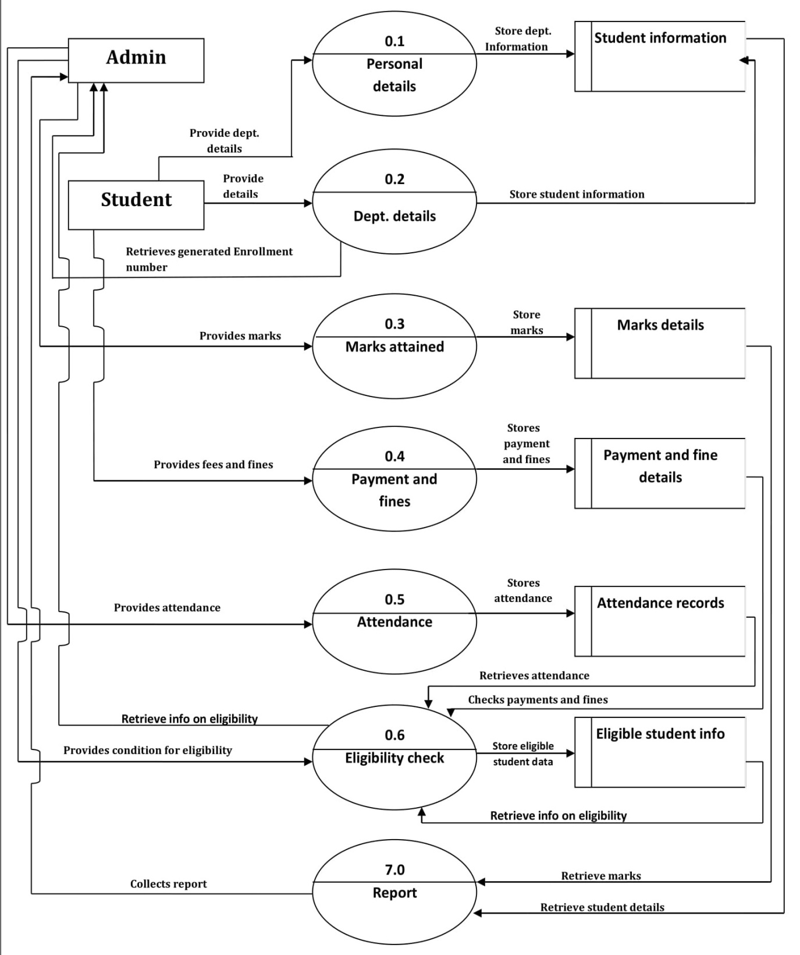
FIRST LEVEL DFD

Slide 10
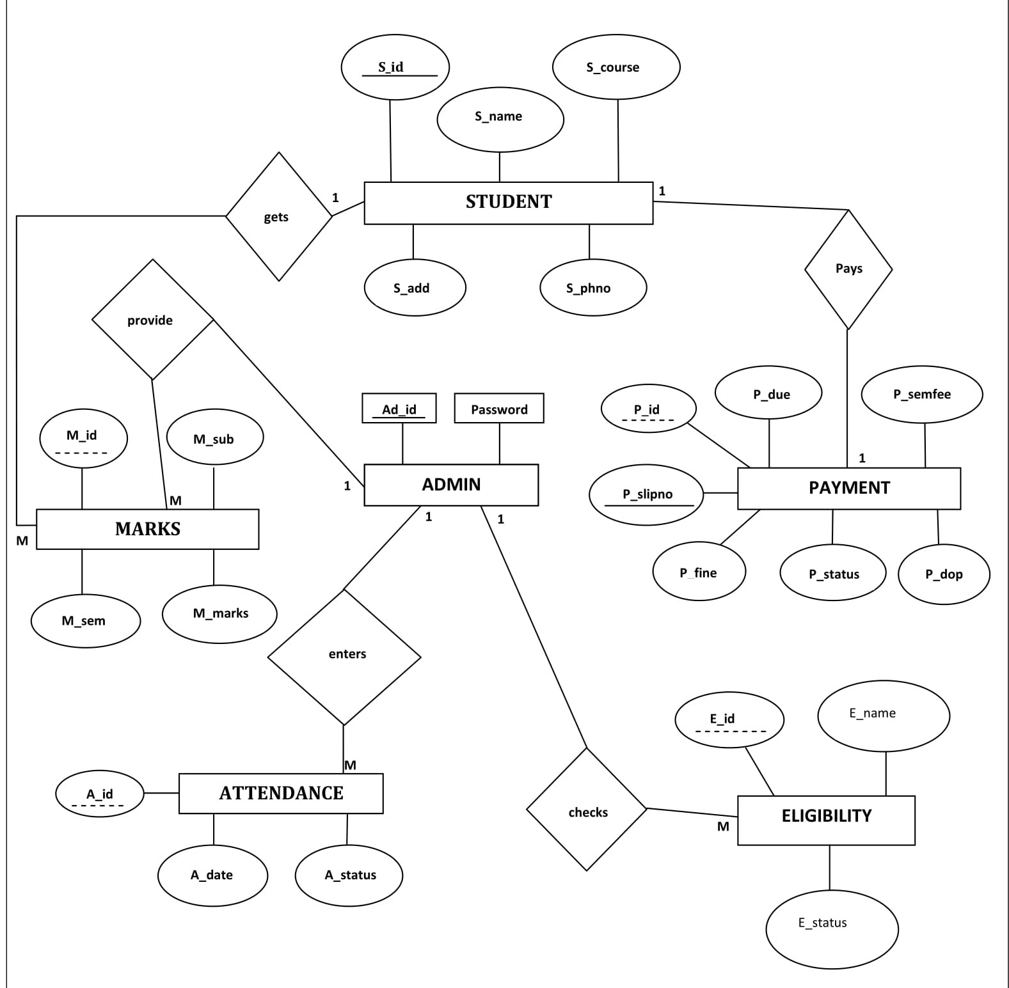
6) ER Diagram

Slide 11
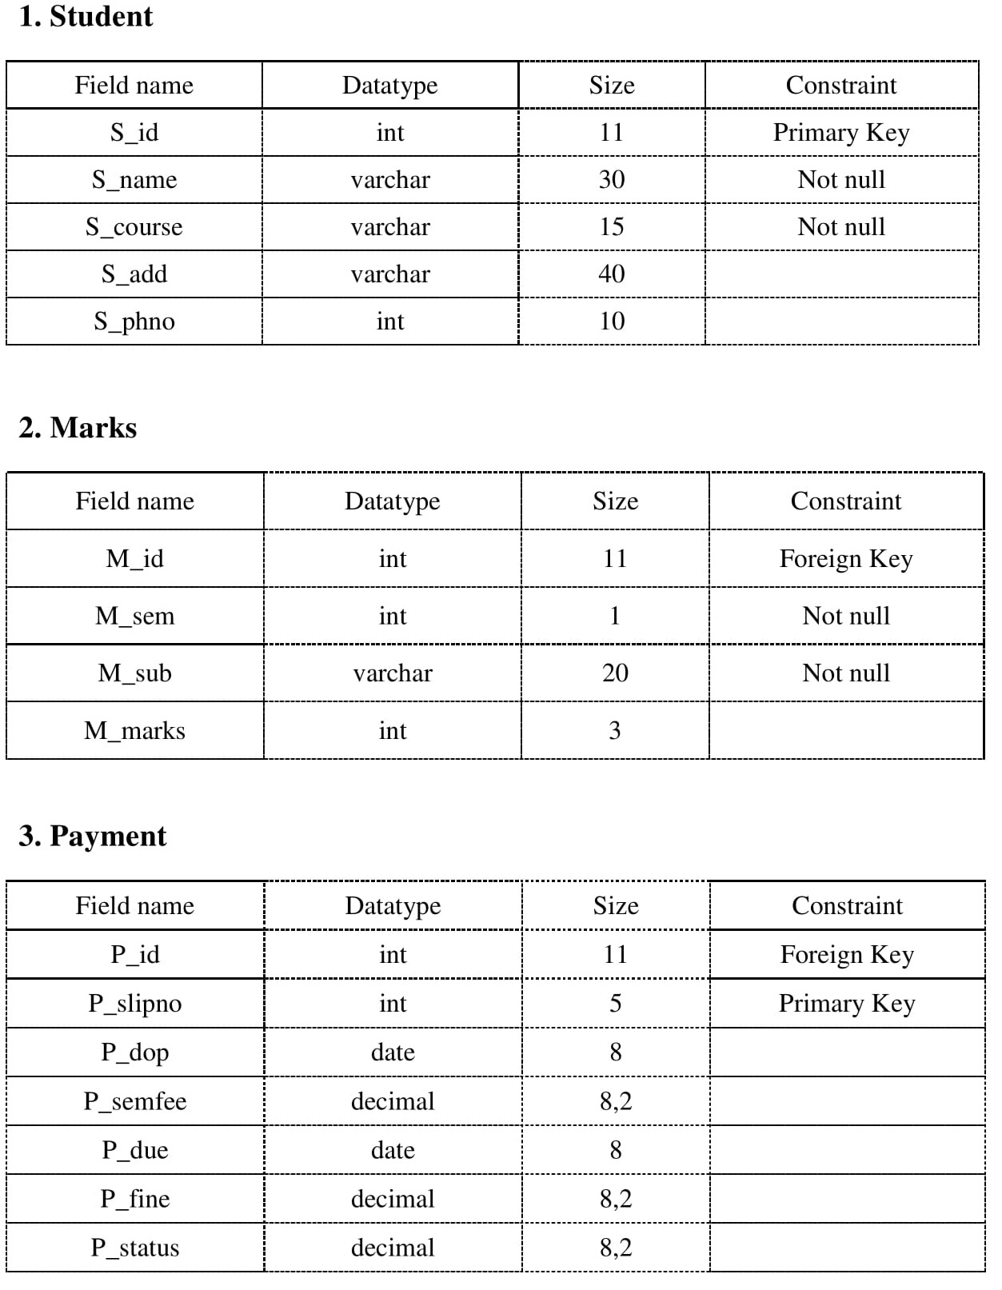
7. Table Structure

Slide 12
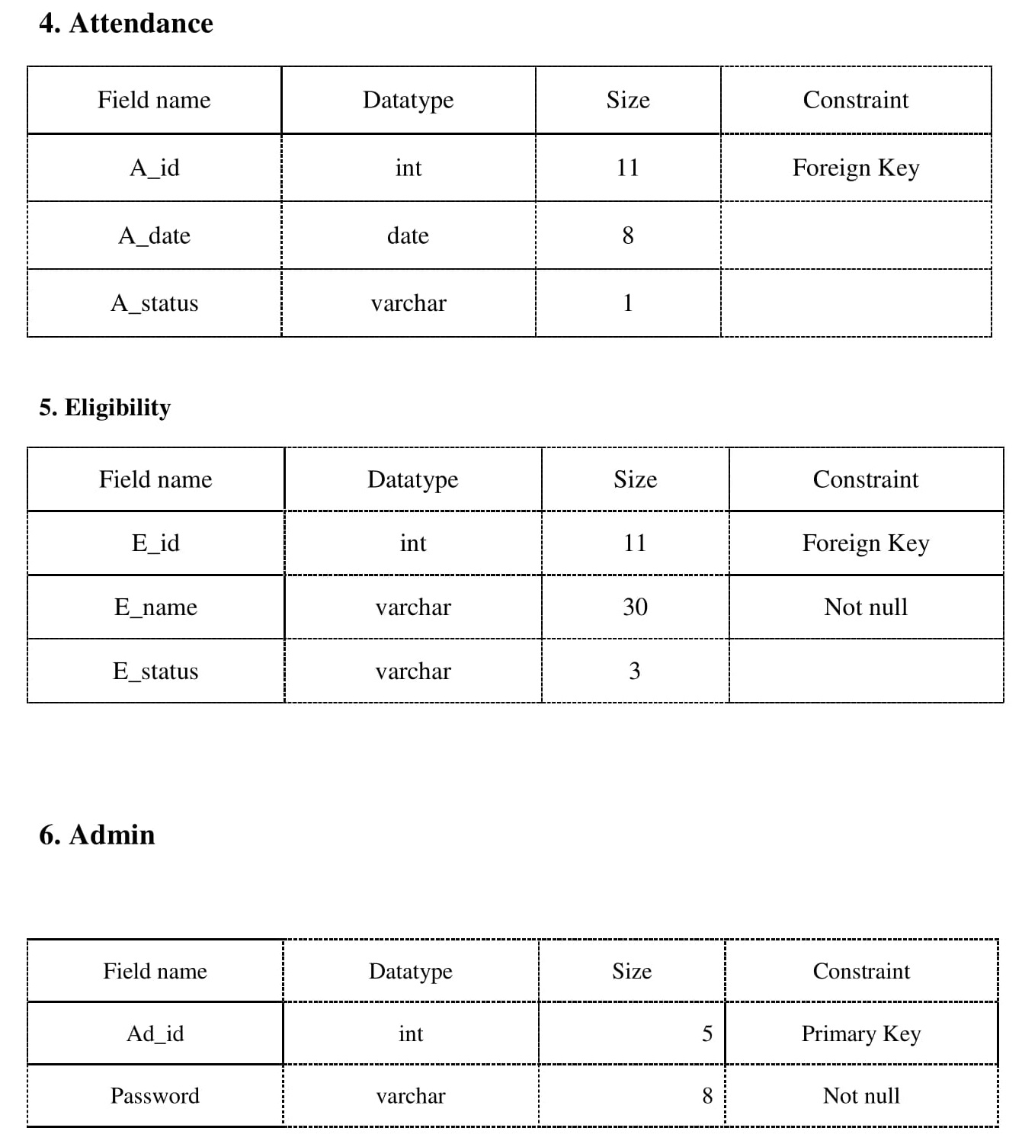

Slide 13
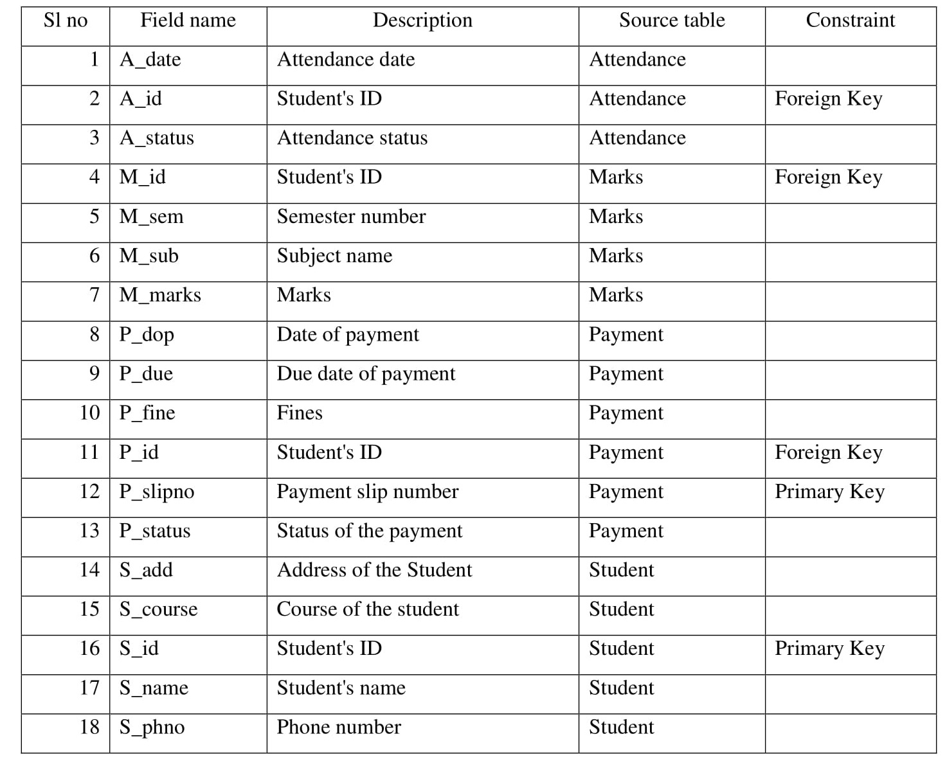
8. Data Dictionary

Slide 14
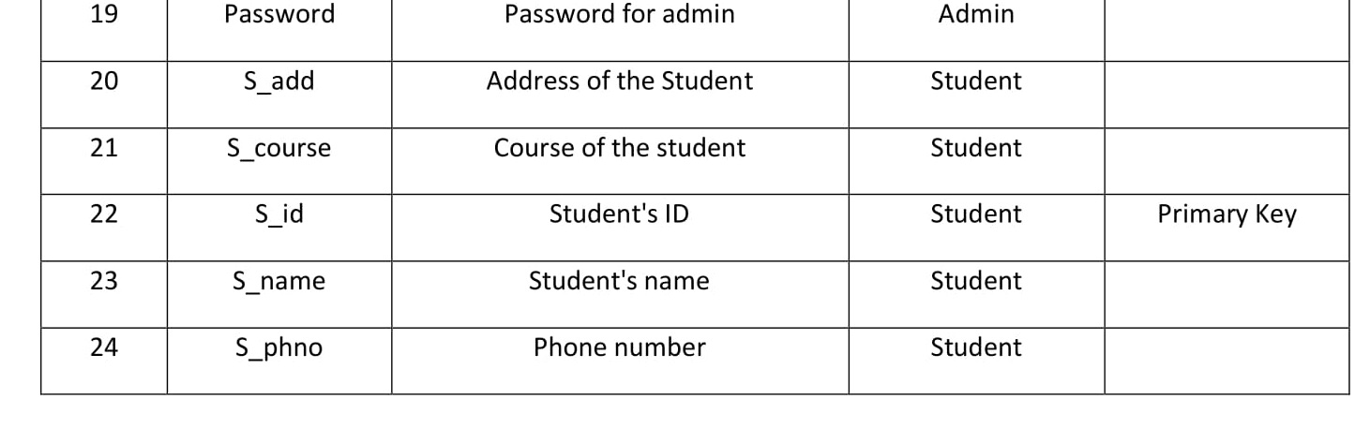

Slide 15
The system that will be developed based on our synopsis report will be able to store student details like personal details, marks obtained by the student during exams, attendance records and everything related to the payment section.
As our system will be built at administrative end, it will help the administrators to reduce the workload that exist in the manual system and minimizing the probability of losing any data. This system will change the way of viewing the data and help them to do their work in a very less amount of time.
Few of the important characteristics that this system will provide are as follows:
Search and view information of any student based on their enrollment number.
Modify and delete any stored information.
Check if the student is eligible or not to give the exam.
Well designed reports.
This system will provide user friendly approach and eliminate the hard work faced by the existing (manual) system.
This is just the synopsis of the project and any content of this report may be changed later while developing the application to meet the goal of our system.
9. Conclusion

